Slide 1
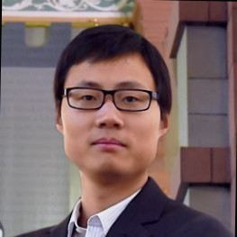
Lei Xu, Ph.D.
Post doctoral
Energy & Geoscience Institute
Department of Civil & Environmental Engineering
Research Interest
Geological Carbon Sequestration
Data processing and analyzing
Geo-material characterization and analysis

Slide 2
